Slide 1
Indian Empires:
1100 BCE – 500CE
SSWH2.A&B

Slide 2
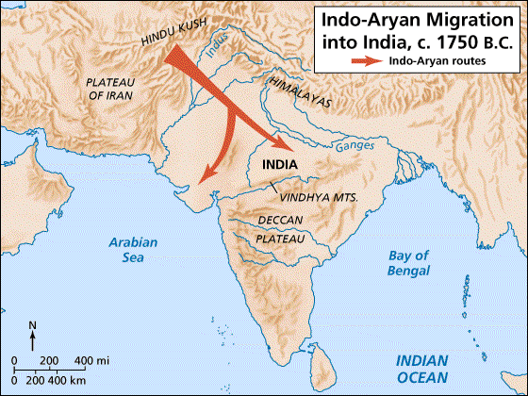
I. Early Aryan Migrations
Beginning around 1750 BCE – the Aryans migrated from Europe into the Indo-Gangetic Plain.
They brought their religious texts with them.
  “Vedas”

Slide 3
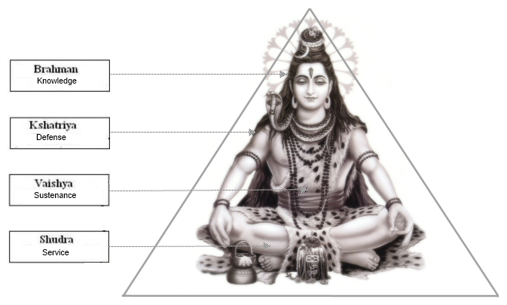
II. The Caste System
Indian society was divided into very rigid social classes. Moving from a lower social class to a higher one was very rare.

Slide 4
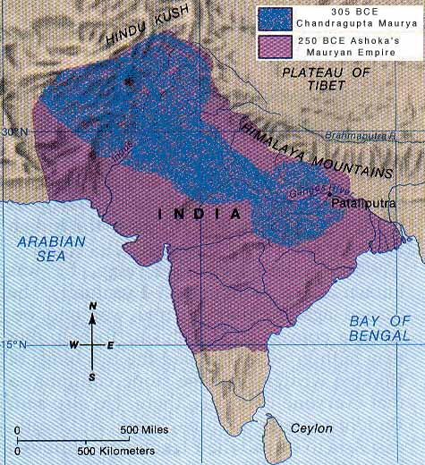
III. Mauryan Empire (Chandragupta)
A. For centuries, India was made up of numerous independent groups.
B. It was united under the Mauryan Empire in 321 BCE.

Slide 5
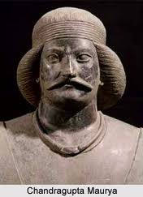
III. Mauryan Empire (Chandragupta)
C. Mauryans were led by Chandragupta
  He came to power by raising an army and killing the king before him.
  Maintained power by force.

Slide 6
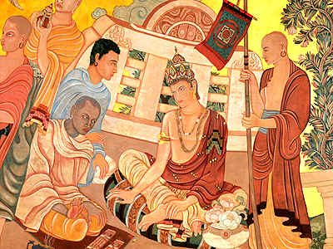
IV. Mauryan Empire (Ashoka)
A. Chandragupta’s grandson Ashoka became king next.
B. Fought a war against Kalinga that cost 100,000+ lives
C. Decided to rule using the teachings of Buddha

Slide 7
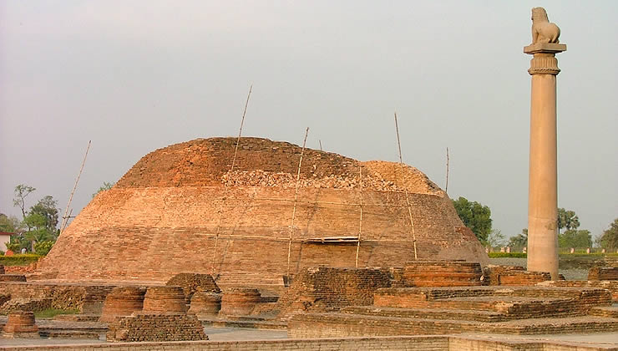
IV. Mauryan Empire (Ashoka)
D. Ashoka built monuments to the Buddha all across the empire to remind people of his teachings.
  “Proper behavior towards servants and employees, respect for mother and father, generosity to friends, companions, relations, Brahmans, and Ascetics, and not killing living beings.

Slide 8
IV. Mauryan Empire (Ashoka)
E. After the death of Ashoka the Mauryan Empire fell apart, and the land was taken by several different kingdoms
Reflection: This statement is taken from one of Ashoka’s pillars. In what ways would believing in this teaching change the way he led his ancient empire?
  “All men are my children. What I desire for my own children, and I desire their welfare and happiness both in this world and the next, that I desire for all men. You do not understand to what extent I desire this, and if some of you do understand, you do not understand the full extent of my desire.”

Slide 9
V. Gupta Empire
The second Indian empire (320-535 AD)
  Led by emperors:
    Chandra Gupta I (not related to Chandragupta Maurya)
    Samundra Gupta
    Chandra Gupta II
These emperors started a “golden age” by increasing India’s wealth through trade and investing in the arts.

Slide 10
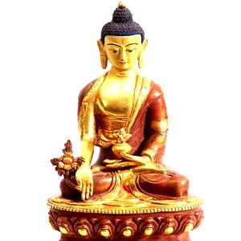
V. Gupta Empire

Slide 11
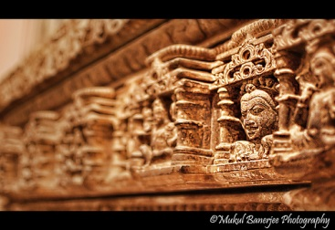
V. Gupta Empire

Slide 12
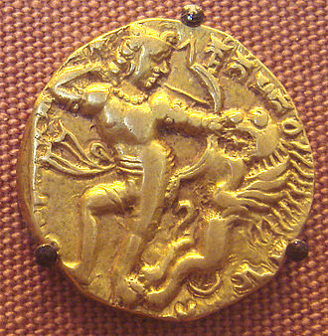
V. Gupta Empire

